Slide 1
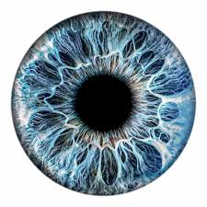
iDETECT: AI POWERED RETINAL DISEASE DETECTION FROM FUNDUS IMAGES
SHAHBAAZ AHMED SADIQ
FAHAD ABDULRAHMAN ALOTHMAN

Slide 2
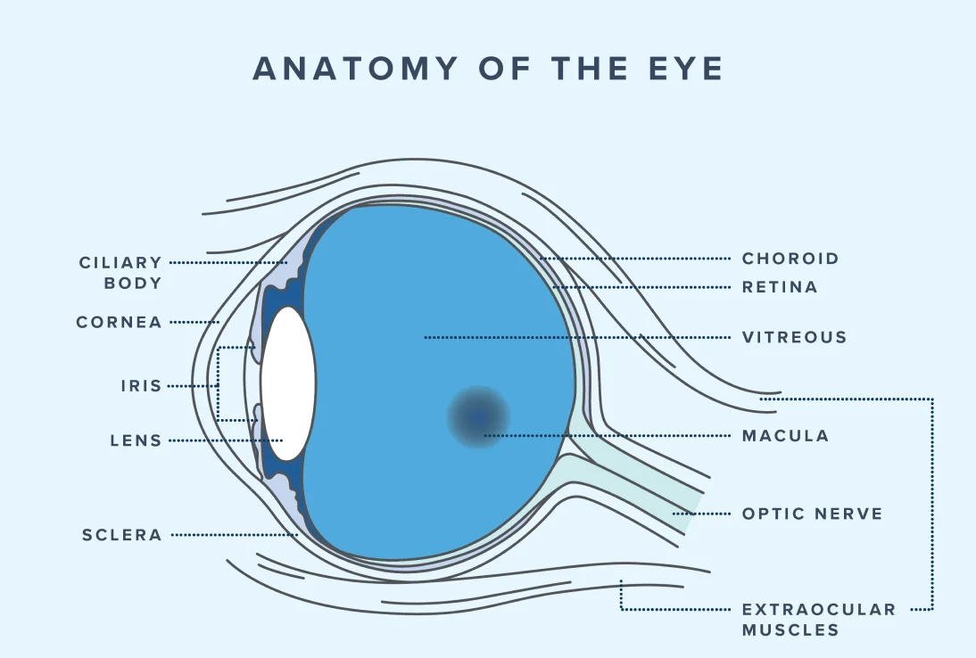
CONTENTS
INTRODUCTION
RET-CLIP EXPLAINED — AND HOW WE APPLIED IT
CHALLENGES FACED
PROMPT GENERATION
ZERO SHOT EVALUATION
RESULTS

Slide 3
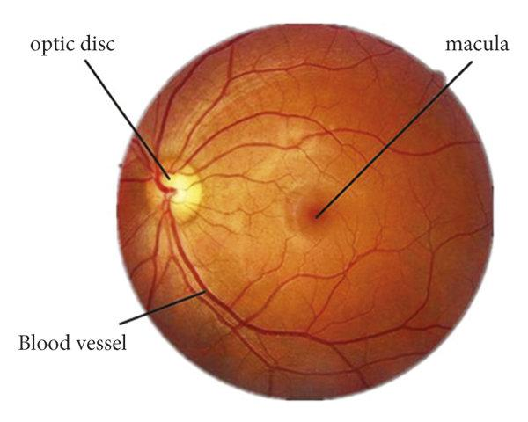
INTRODUCTION
Retinal Disease Detection: Prevent vision loss early: many eye diseases start quietly; early detection can save sight
Fundus photos: color pictures of the back of the eye (retina) taken with a standard eye camera
Catches silent changes from diabetes, glaucoma, macular degeneration, and high blood pressure before vision drops.

Slide 4
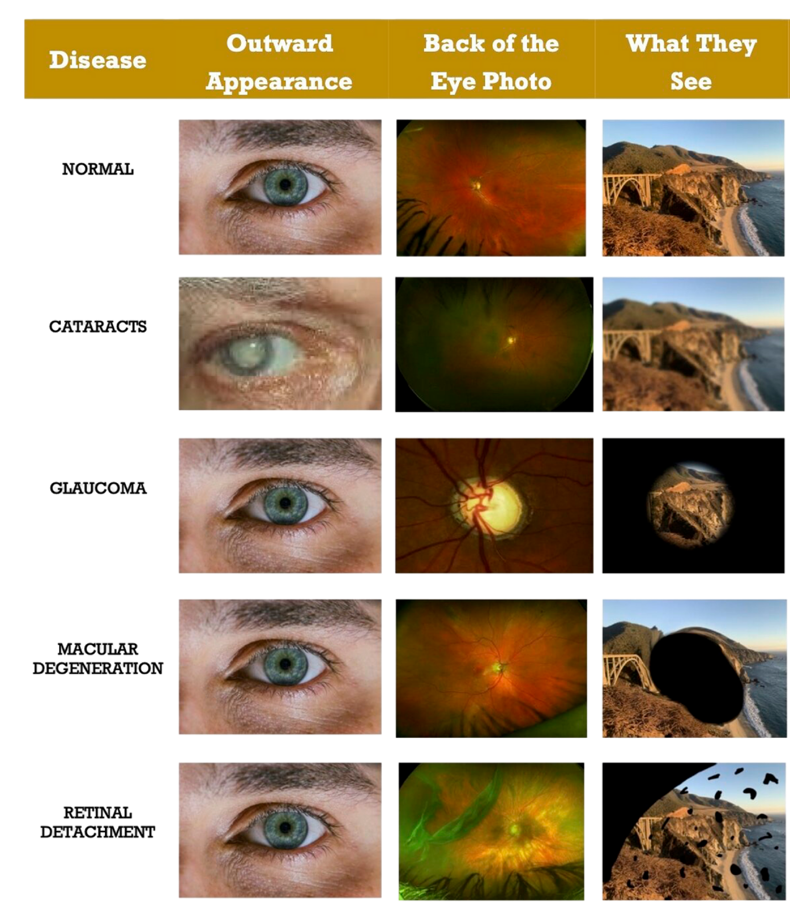

Slide 5
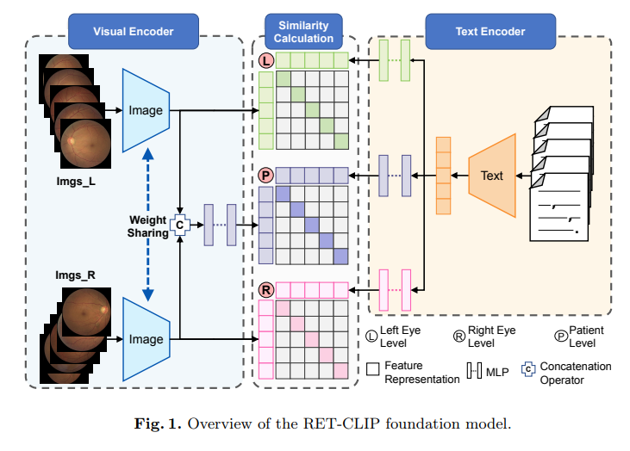
RET-CLIP FOUNDATIONAL MODEL

Slide 6
RET-CLIP: OUR PRACTICAL BUILD
TOPIC | RET-CLIP (ORIGINAL) | OUR PROJECT
Dataset | Retinal datasets with Chinese-language metadata (various sources) | ODIR-5K binocular fundus set (left + right) with keywords
Text encoder | Trained on Chinese | English biomedical (PubMedBERT/BioBERT)
Prompts | Best in Chinese | Plain English from ODIR keywords
Images | Both eyes (left + right) | Both eyes (left + right)
How we test | Zero-shot from words | Zero-shot + simple extra learner (linear probe)
Data handling | Standard files | Clean splits + LMDB for fast, repeatable runs
Aim | Show open-vocabulary idea | Make it practical in English and easy to evaluate

Slide 7

CHALLENGES
GPU unavailability → training and feature extraction were very slow
Runtime disconnections during long cells/runs
Memory limits (RAM) → out-of-memory errors on big batches
Library/version conflicts (Torch/CUDA/packages) blocking runs
Language mismatch (Chinese text model vs. English prompts) affecting accuracy

Slide 8
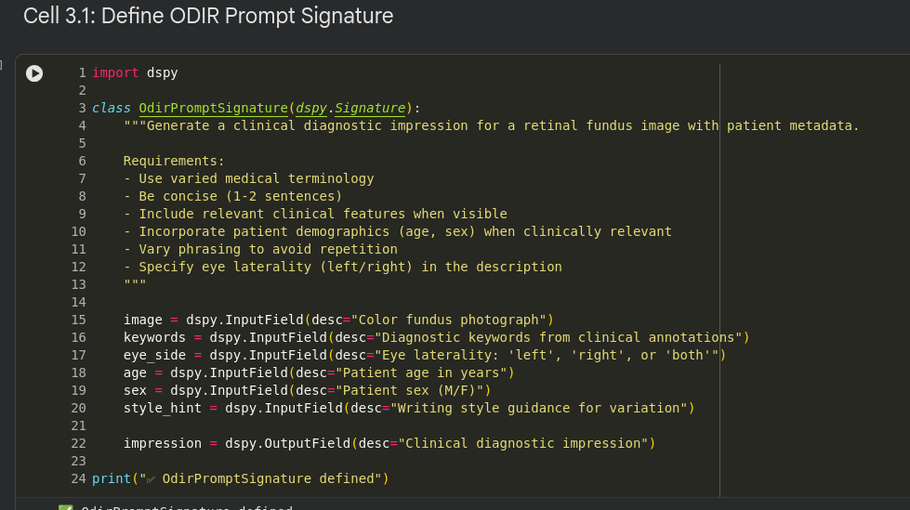
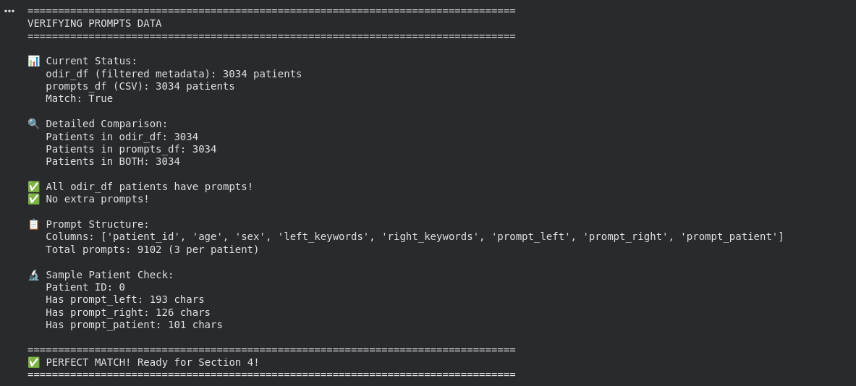
Prompt Geneartion

Slide 9
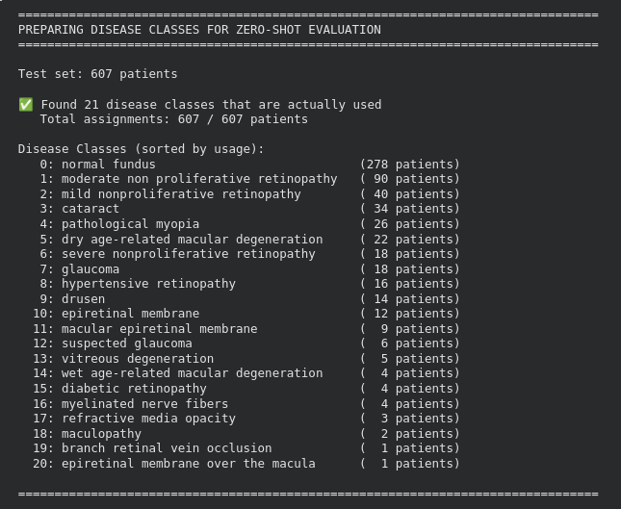
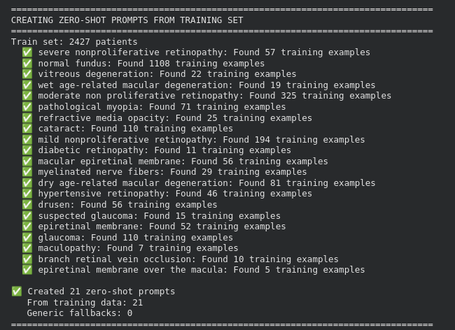
Zero-shot evaluation

Slide 10
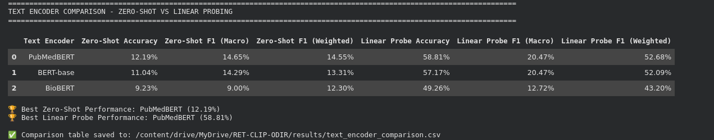
Results

Slide 11

THANK YOU
SHAHBAAZ AHMED SADIQ – 202415720
FAHAD ABDULRAHMAN ALOTHMAN - 201673400

